Slide 1

Cybersecurity Outreach Project
Created by Jon McCarrick

Slide 2

Fresenius Kidney Care
Dialysis clinic
Dialysis is a way of cleaning your blood. It is a medical treatment for people with ESRD that does some of the work healthy kidneys would do, including:
Removing waste, salt and extra water from your body
Regulating your body’s fluid balance
Helping to control your blood pressure

Slide 3
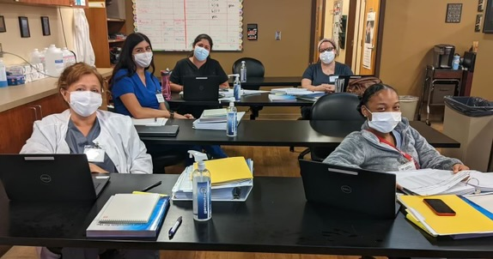
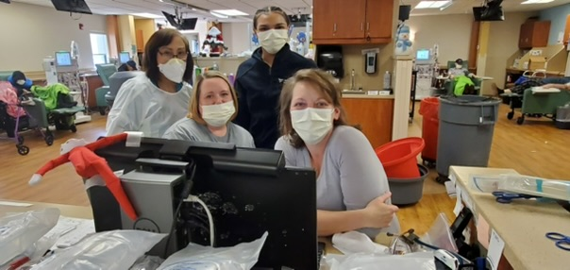
People who I presented to

